Slide 1

Hybridity & Counter-Terrorism
Prof. Fiona de Londras
Durham Law School
SECILE www.secile.eu

Slide 2
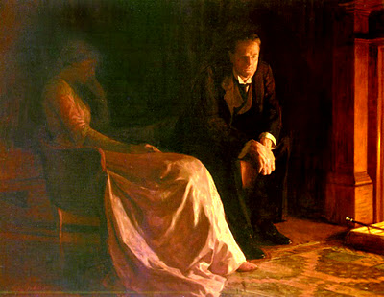

Slide 3

“...the impulse to commit violence is fuelled by
Western values thwarted, the notion of fixed
differences is enhanced by conventional
multiculturalism, and the metaphor of war and
all it permits is a core part of Western culture.
The grammar is there to inspire the…terrorist…as
it is there to inspire the conventional warfare of
phosphorous shell, cluster bomb and patriotic
martyrdom...If there is one thing a critical
criminology can tell us it is how the experience of
injustice can lead to further injustice…the
creation of demonisation and othering can permit
the impermissible”

Slide 4

“The organizational ability to carry out acts of
terrorism stems not from theology but from the
organizational strength of a mutual aid society,
religious or secular….Knowing that radical religious
terrorists draw their strength from organizations that provide social welfare
services through mutual aid suggests that competing provision of particular
social services will be an effective tool in the struggle against terrorist
violence”

Slide 5

“For whom did everything change on September 11th, 2001?...What changed was this: the danger was real because certain men were afraid. They knew they were targeted because of who they are”

Slide 6
“…smart people when you put one measure they will [adapt]…
like in the Sahel in Somalia they don’t have a safe haven any longer,
so they go to Libya…that’s the displacement…And that
means that you also have to go and work on Libya. But it doesn’t
mean that your first measure wasn’t effective. It also doesn’t mean
you can stop with your first measure because soon as you stop with
your first measure they will move back…but that’s normal that people
try to work around restrictions. The more restrictions you put the more
difficult it will be and the easier maybe you catch them because if
you can’t use the formal banking system and you just have to use the
informal it’s more difficult”
SECILE/IV/6 EUCTCO

Slide 7
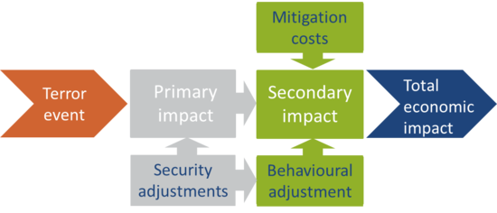
“For the moderate, severe, and nuclear cases, [direct] costs are estimated at
approximately $11 billion, $183 billion, and $465 billion per year,
respectively. Real annual resource costs of U.S. counterterrorism efforts in
the three cases are found to be $10 billion, $200 billion, and $300 billion,
respectively. The analysis suggests that the marginal benefit may exceed the
marginal cost, and thus that spending may in fact be little…”
RAND, 2003 Preliminary Analysis
Cost of 9/11 Plot:
$400,000-500,000

Slide 8
“The problem is that very often if you disrupt terrorism activity…you have saved lives,
But you don’t talk about this because you don’t reveal your measures. Does it mean
You have made use of measures which cannot be see[n in] daylight? No, because in
The future you want to make use of the same measures, and they cannot be disclosed…
You cannot talk about the successes…it’s difficult to say ‘this measure is a useful
measure’ because you cant talk about it, you can’t talk about your cooperation with
intelligence services without putting in danger informants and techniques which are
constantly discussed in our [operational] fora and our discussions and coordination
efforts…otherwise you take away possibilities for the future and you give a lot of
information to…the terrorists and that’s not the purpose of our work. We want to continue
to be legal and legitimate and to be effective in the future and that means you
cannot promote, and not always inform the public at large of what you’re doing”
-SECILE/IV/4 EUROJUST

Slide 9
“..we try to combat terrorism at an early stage, but these results you
never see in public. So…having a serious talk to suspicious people because
of their behaviour—going to a radical mosque—you will never see that as
a result on the policy level. But you did [have a result] because he was now
impressed and there is this state enforcement on him…
But that is one impact and you will never be able to measure it. So the
prevention of a terrorist act as such is difficult to measure…”
SECILE/IV/4 EUROPOL

Slide 10
Domestic
Policing
International
Military
Local
Community
Virtual
Surveillance
Community
Law
Intelligence
Coordination
Law
Counter-radicalisation
Disruption
Counter-radicalisation
Intelligence

